Slide 1
Recap
ER Model Basics
What is the Degree of a Relationship? And How to represent it.
Unary Relationship
Binary Relationship
Ternary Relationship
What is Mapping Cardinality?
one-to-one
one-to-many
many-to-one
many-to-many
Relationship Participation Constraints and it’s types-
Total Participation
Partial Participation

Slide 2
Content
Steps in ER Modelling
ER Diagram Case study
Merits & Demerits of ER Modeling
Summary of ER Modeling
References

Slide 3
Steps in ER Modeling
Identify the Entities
Find Relationships
Identify the key attributes for every Entity
Identify other relevant attributes
Draw complete E-R diagram with all attributes including Primary Key
Review your results with your Business users

Slide 4
Case Study: college Database
Assumptions :
A college contains many departments
Each department can offer any number of courses
Many instructors can work in a department
An instructor can work only in one department
For each department there is a Head
An instructor can be head of only one department
Each instructor can take any number of courses
A course can be taken by only one instructor
A student can enroll for any number of courses
Each course can have any number of students

Slide 5
Steps in ER Modeling
Step 1: Identify The Entities
Details are:
A college contains many departments
Each department can offer any number of courses
Each Course belong to only one Department
Many instructors can work in a department
An instructor can work only in one department
For each department there is a Head
An instructor can be head of only one department
Each instructor can take any number of courses
A course can be taken by only one instructor
A student can enroll for any number of courses
Each course can have any number of students
Department
Course
Instructor
Student

Slide 6
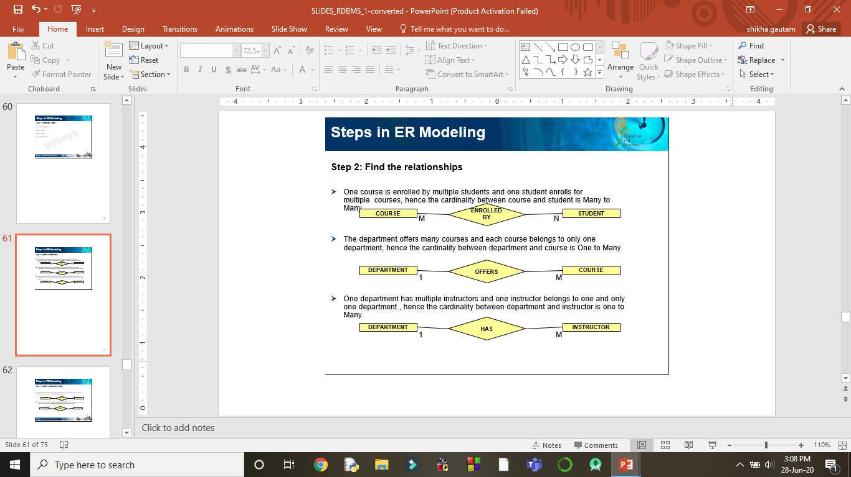
Steps in ER Modeling
Step 2: Find the Relationships and Cardinality
A student can enroll for any number of courses
Each course can have any number of students

Slide 7
Step 2: Find the Relationships and Cardinality
Each department can offer any number of courses
Each Course belong to only one Department

Slide 8
Step 2: Find the Relationships and Cardinality
Many instructors can work in a department
An instructor can work only in one department

Slide 9
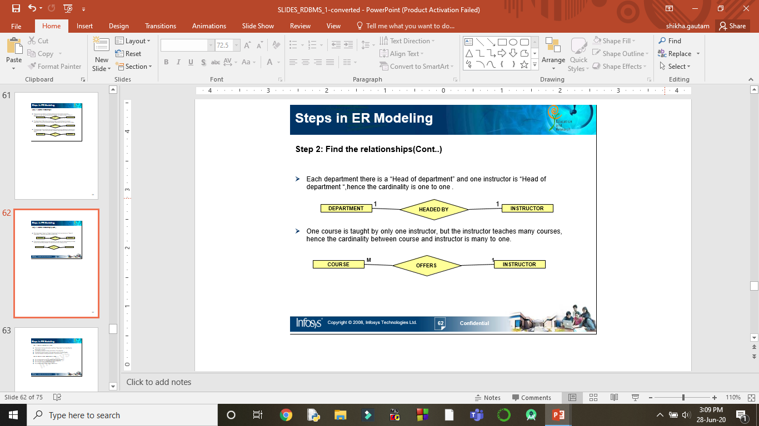
Step 2: Find the Relationships and Cardinality
For each department there is a Head
An instructor can be head of only one department

Slide 10
Step 2: Find the Relationships and Cardinality
A course can be taken by only one instructor
Each instructor can take any number of courses

Slide 11
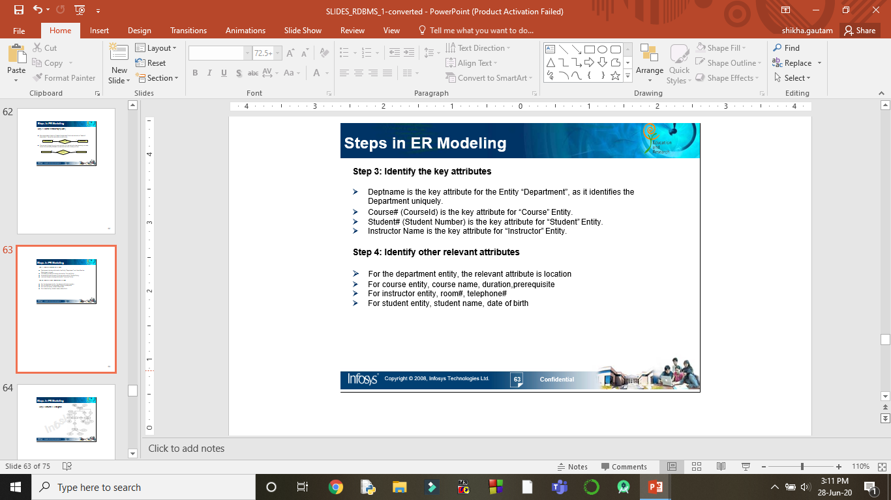
Steps in ER Modeling
Step 3: Identify the Key Attribute
Step 4: Identify the other Relevant Attribute

Slide 12
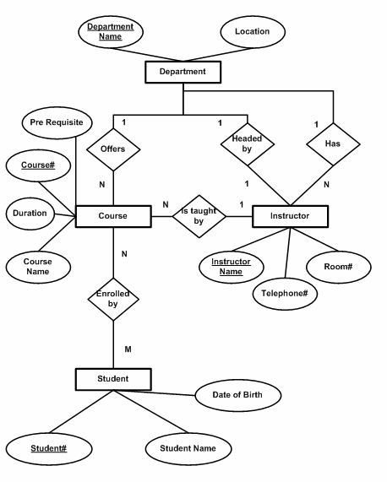
Steps in ER Modeling
Step 5:
Draw the E-R diagram

Slide 13

ER Case Study – Online Retail Application

Slide 14
Steps in ER Modeling
Step 1: Identify The Entities
Customer
Item
Bill
Supplier

Slide 15
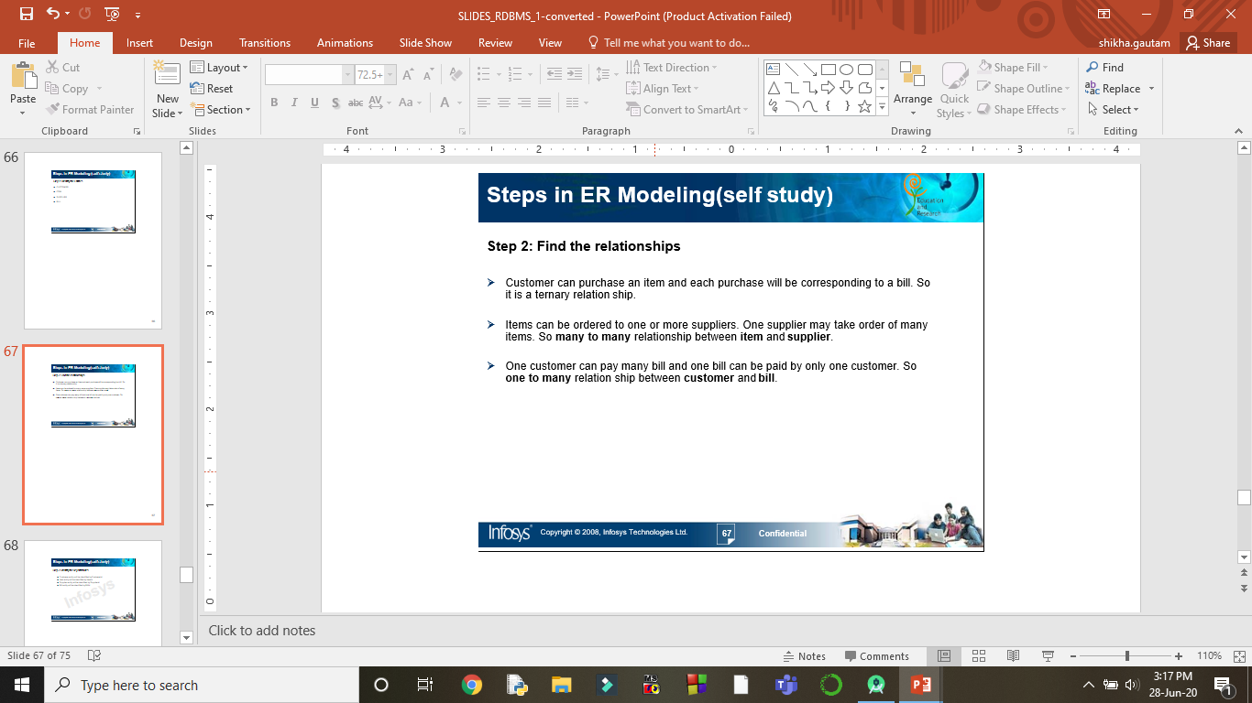
Steps in ER Modeling
Step 2: Find the Relationships and Cardinality

Slide 16
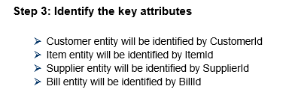
Steps in ER Modeling
Step 3: Identify the Key Attribute

Slide 17
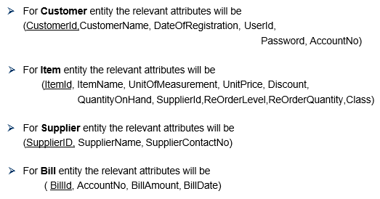
Steps in ER Modeling
Step 4: Identify the other Relevant Attribute

Slide 18
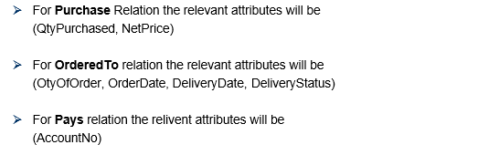
Steps in ER Modeling

Slide 19
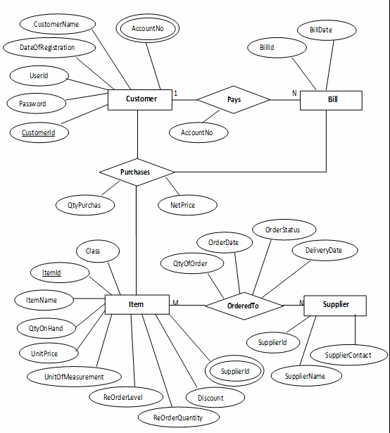
Steps in ER Modeling
Step 5:
Draw the E-R diagram

Slide 20
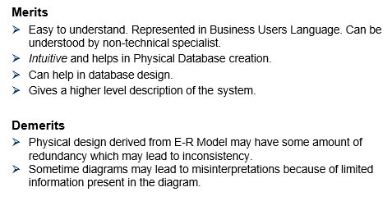
Merits and Demerits of ER Modeling

Slide 21
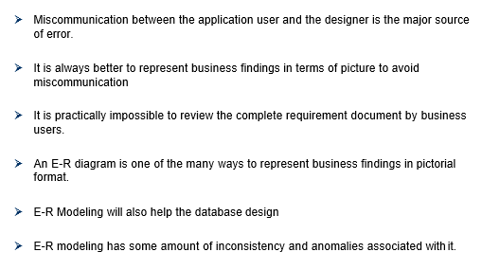
Summary of ER Modeling

Slide 22
References
Elmasri, Navathe, “ Fundamentals of Database Systems”, Addision Wesley
Korth, Silbertz, Sudarshan,” Database Concepts”, McGraw Hill
Date C J, “An Introduction to Database Systems”, Addision Wesley
Thank You

